Slide 1

Naive Bayes and NLP

Slide 2
Naive Bayes and NLP
In this section we will begin a discussion on using raw string text for machine learning models.
This idea in general is known as “Natural Language Processing”.

Slide 3
Naive Bayes and NLP
Section Overview
Naive Bayes Algorithm and NLP
Extracting Features from Text Data
Text Classification Project
Keep in mind:
This section focuses on supervised learning text tasks. We will discuss unsupervised text tasks later on.

Slide 4
Let’s get started!

Slide 5
Naive Bayes
Part One: Bayes’ Theorem

Slide 6
Natural Language Processing
Naive Bayes is the shorthand for a set of algorithms that use Bayes’ Theorem for supervised learning classification.
Bayes’ Theorem is a probability formula that leverages previously known probabilities to define probability of related events occuring.

Slide 7
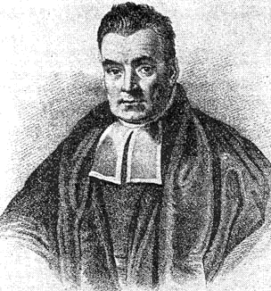
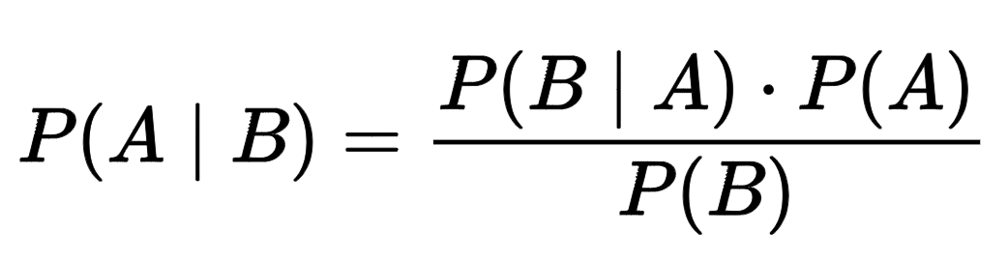
Natural Language Processing
Naive Bayes methods are a set of supervised learning algorithms based on applying Bayes’ Theorem.

Slide 8
Natural Language Processing
1700s: Thomas Bayes was a Presbyterian minister in England who studied theology, statistics, and logic.

Slide 9
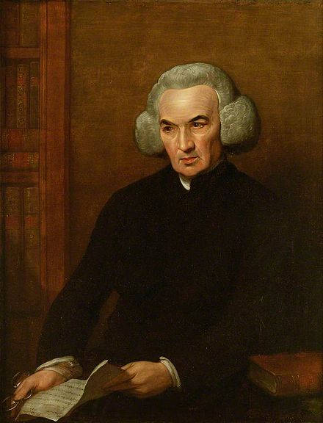
Natural Language Processing
1700s: Bayes’ Theorem was published after his death! Richard Price edited and published his notes.

Slide 10
Natural Language Processing
Bayes’ Theorem
A and B are events
P(A|B) is probability of event A given that B is True.
P(B|A) is probability of event B given that A is True.
P(A) is probability of A occurring.
P(B) is probability of B occurring.

Slide 11
Natural Language Processing
Bayes’ Theorem
Let’s walk through a quick example!

Slide 12
Natural Language Processing
Imagine the following situation for a city:
Every apartment in a building is fit with a fire alarm detection system.
However, there are false alarms where smoke is detected but there is not a dangerous fire to put out (e.g. smoke from an oven).

Slide 13
Natural Language Processing
The associated probabilities:
Actual dangerous fires occur only 1% of the time.
Smoke alarms are not very good, and go off about 10% of the time.
When there is an actual dangerous fire, 95% of the time the smoke alarms go off.

Slide 14
Natural Language Processing
Question to answer:
If you get a smoke alarm detecting a fire, what is the probability that there actually is a dangerous fire?

Slide 15
Natural Language Processing
In terms of probability events:
Event A: Dangerous Fire
Event B: Smoke Alarm Triggered
P(A|B):
Probability of Fire given Smoke Alarm
P(B|A):
Probability of Smoke Alarm given a dangerous fire

Slide 16
Natural Language Processing
In terms of probability events:
Event A: Dangerous Fire
Event B: Smoke Alarm Triggered
P(A|B):
Probability of Fire given Smoke Alarm
P(B|A):
Probability of Smoke Alarm given a dangerous fire

Slide 17
Natural Language Processing
Imagine the following situation for a city:
Actual dangerous fires occur only 1% of the time. P(Fire) = 1/100
Smoke alarms are not good and go off about 10% of the time. P(Smoke) = 1/10
When there is an actual dangerous fire, 95% of the time the smoke alarms go off.
P(Smoke|Fire) = 95/100

Slide 18
Natural Language Processing
Using Bayes’ Theorem:
P(Fire|Smoke) = P(Smoke|Fire)*P(Fire)/P(Smoke)

Slide 19
Natural Language Processing
Using Bayes’ Theorem:
P(Fire|Smoke) = P(Smoke|Fire)*P(Fire)/P(Smoke)
P(Fire|Smoke) = 0.95 * 0.01 / 0.1
P(Fire|Smoke) = 0.095
P(Fire|Smoke) = 9.5%

Slide 20
Natural Language Processing
Let’s move on to explore how Bayes’ Theorem can be extended to perform classification.
Specifically, we’ll focus on using Bayes’ Theorem for Natural Language Processing Classification.

Slide 21
Naive Bayes
Part Two: Naive Bayes

Slide 22
Natural Language Processing
Let’s move on to explore how Bayes’ Theorem can be extended to perform classification.
Specifically, we’ll focus on using Bayes’ Theorem for Natural Language Processing Classification.

Slide 23
Natural Language Processing
Let’s first walkthrough the conversion of Bayes’ Theorem to a machine learning model!

Slide 24
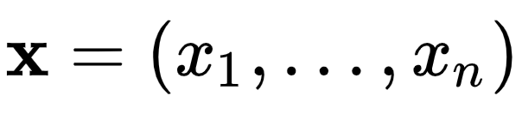
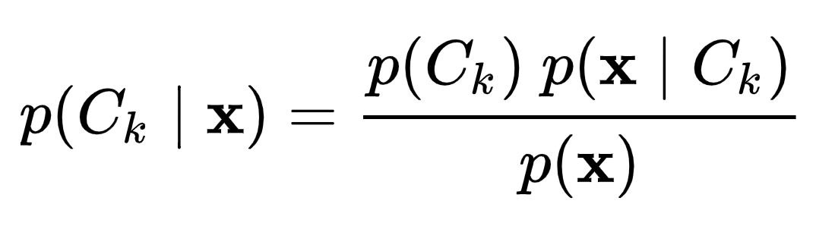
Natural Language Processing
We model the probability of belonging to a class given a vector of features.

Slide 25
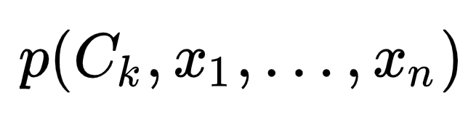
Natural Language Processing
The numerator is equivalent to a joint probability model:

Slide 26
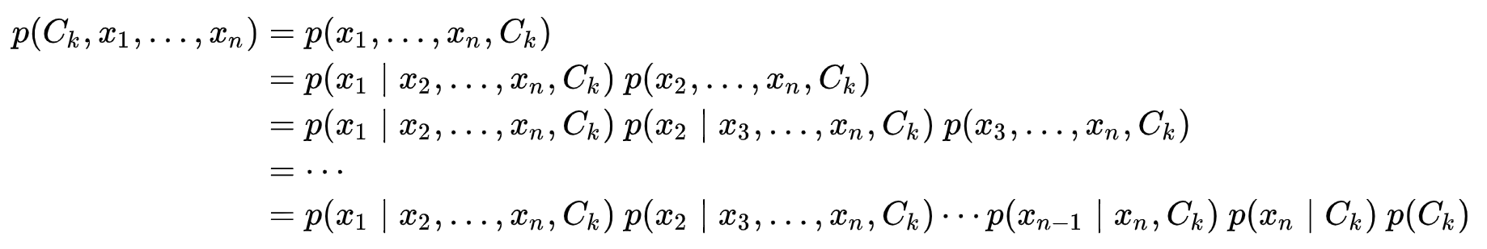
Natural Language Processing
The chain rule can rewrite this numerator as a series of products of conditional probabilities:

Slide 27
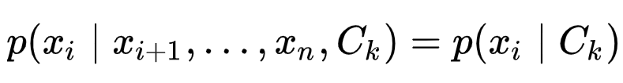
Natural Language Processing
Finally we need to make an assumption, we assume all x features are mutually independent of each other.
Allowing for this conditional probability:

Slide 28
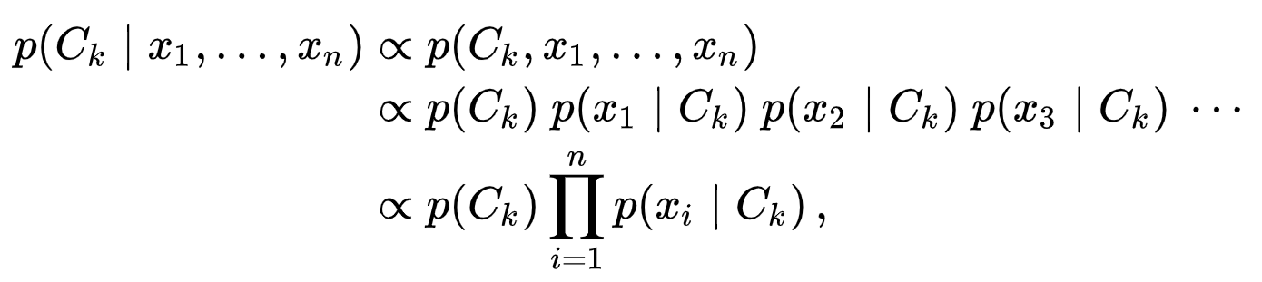
Natural Language Processing
Then the joint model (the full Naive Bayes model) is fully written as:

Slide 29
Natural Language Processing
Where ∝ denotes proportionality:

Slide 30
Natural Language Processing
Let’s walk through an example of using this Naive Bayes model.

Slide 31
Natural Language Processing
There are many variations of Naive Bayes models, including:
Multinomial Naive Bayes
Gaussian Naive Bayes
Complement Naive Bayes
Bernoulli Naive Bayes
Categorical Naive Bayes
Check out the online documentation!

Slide 32
Natural Language Processing
We will be focusing on Multinomial Naive Bayes, since its used most often in the context of natural language processing.
Let’s imagine we want to create a movie review aggregation website where we need to classify movie reviews into two categories: positive or negative.

Slide 33
Natural Language Processing
Using previous reviews, we can have someone manually label them in order to create a labeled data set.
Then in the future, we could use our machine learning algorithm to automatically classify a new text review for us.

Slide 34
Natural Language Processing
But how do we actually train on this text data?
Multinomial Bayes can work quite well with a simple count vectorization model (counting the frequency of each word in each document).

Slide 35



Natural Language Processing
Begin by separating out document classes:
25
10

Slide 36
Natural Language Processing
Create “prior” probabilities for each class:
25
10

Slide 37
Natural Language Processing
Create “prior” probabilities for each class:
P(pos) = 25/35
P(neg) = 10/35

Slide 38
Natural Language Processing
We will use these later!
P(pos) = 25/35
P(neg) = 10/35

Slide 39
Natural Language Processing
Start with count vectorization on classes:

Slide 40
Natural Language Processing
Start with count vectorization on classes:
10 | 2 | 8 | 4
movie | actor | great | film
8 | 10 | 0 | 2
movie | actor | great | film

Slide 41
Natural Language Processing
Calculate conditional probabilities per class and word.
10 | 2 | 8 | 4
movie | actor | great | film
8 | 10 | 0 | 2
movie | actor | great | film

Slide 42
Natural Language Processing
Calculate conditional probabilities:
10 | 2 | 8 | 4
movie | actor | great | film
P(movie|pos)
8 | 10 | 0 | 2
movie | actor | great | film

Slide 43
Natural Language Processing
Calculate conditional probabilities:
10 | 2 | 8 | 4
movie | actor | great | film
P(movie|pos) = 10/24=0.42
8 | 10 | 0 | 2
movie | actor | great | film

Slide 44
Natural Language Processing
Calculate conditional probabilities:
0.42 | 0.08 | 0.33 | 0.17
10 | 2 | 8 | 4
movie | actor | great | film
P(movie|pos) = 10/24 = 0.42
P(actor|pos) = 2/24 = 0.08
P(great|pos) = 8/24 = 0.33
P(film|pos) = 4/24 = 0.17
8 | 10 | 0 | 2
movie | actor | great | film

Slide 45
Natural Language Processing
Calculate conditional probabilities:
0.42 | 0.08 | 0.33 | 0.17
10 | 2 | 8 | 4
movie | actor | great | film
P(movie|neg)= 8/20 = 0.4
P(actor|neg) = 10/20 = 0.5
P(great|neg) = 0/20 = 0
P(film|neg) = 2/20 = 0.1
8 | 10 | 0 | 2
movie | actor | great | film

Slide 46
Natural Language Processing
Calculate conditional probabilities:
0.42 | 0.08 | 0.33 | 0.17
10 | 2 | 8 | 4
movie | actor | great | film
P(movie|neg)= 8/20 = 0.4
P(actor|neg) = 10/20 = 0.5
P(great|neg) = 0/20 = 0
P(film|neg) = 2/20 = 0.1
0.4 | 0.5 | 0 | 0.1
8 | 10 | 0 | 2
movie | actor | great | film

Slide 47
Natural Language Processing
Now a new review was created:
0.42 | 0.08 | 0.33 | 0.17
10 | 2 | 8 | 4
movie | actor | great | film
“movie actor”
0.4 | 0.5 | 0 | 0.1
8 | 10 | 0 | 2
movie | actor | great | film

Slide 48
Natural Language Processing
Now a new review was created:
0.42 | 0.08 | 0.33 | 0.17
10 | 2 | 8 | 4
movie | actor | great | film
“movie actor”
P(pos)
0.4 | 0.5 | 0 | 0.1
8 | 10 | 0 | 2
movie | actor | great | film

Slide 49
Natural Language Processing
Start with the prior probability
0.42 | 0.08 | 0.33 | 0.17
10 | 2 | 8 | 4
movie | actor | great | film
“movie actor”
P(pos)
25
0.4 | 0.5 | 0 | 0.1
8 | 10 | 0 | 2
movie | actor | great | film
10

Slide 50
Natural Language Processing
Start with prior probability
0.42 | 0.08 | 0.33 | 0.17
10 | 2 | 8 | 4
movie | actor | great | film
“movie actor”
P(pos) = (25/35)
25
0.4 | 0.5 | 0 | 0.1
8 | 10 | 0 | 2
movie | actor | great | film
10

Slide 51
Natural Language Processing
Continue with conditional probabilities
0.42 | 0.08 | 0.33 | 0.17
10 | 2 | 8 | 4
movie | actor | great | film
25
“movie actor”
P(pos)×P(movie|pos)
0.4 | 0.5 | 0 | 0.1
8 | 10 | 0 | 2
movie | actor | great | film
10

Slide 52
Natural Language Processing
Continue with conditional probabilities
0.42 | 0.08 | 0.33 | 0.17
10 | 2 | 8 | 4
movie | actor | great | film
25
“movie actor”
P(pos)×P(movie|pos)×P(actor|pos)
0.4 | 0.5 | 0 | 0.1
8 | 10 | 0 | 2
movie | actor | great | film
10

Slide 53
Natural Language Processing
Continue with conditional probabilities
0.42 | 0.08 | 0.33 | 0.17
10 | 2 | 8 | 4
movie | actor | great | film
25
“movie actor”
(0.71)×(0.42)×(0.08)
0.4 | 0.5 | 0 | 0.1
8 | 10 | 0 | 2
movie | actor | great | film
10

Slide 54
Natural Language Processing
Continue with conditional probabilities
0.42 | 0.08 | 0.33 | 0.17
10 | 2 | 8 | 4
movie | actor | great | film
25
“movie actor”
(0.71)×(0.42)×(0.08) = 0.024
0.4 | 0.5 | 0 | 0.1
8 | 10 | 0 | 2
movie | actor | great | film
10

Slide 55
Natural Language Processing
Calculate this score factor as 0.024
0.42 | 0.08 | 0.33 | 0.17
10 | 2 | 8 | 4
movie | actor | great | film
25
“movie actor”
(0.71)×(0.42)×(0.08) = 0.024
0.4 | 0.5 | 0 | 0.1
8 | 10 | 0 | 2
movie | actor | great | film
10

Slide 56
Natural Language Processing
Score is proportional to P(pos|“movie actor”)
0.42 | 0.08 | 0.33 | 0.17
10 | 2 | 8 | 4
movie | actor | great | film
25
“movie actor”
(0.71)×(0.42)×(0.08) = 0.024
0.4 | 0.5 | 0 | 0.1
8 | 10 | 0 | 2
movie | actor | great | film
10

Slide 57
Natural Language Processing
Score is proportional to P(pos|“movie actor”)
0.42 | 0.08 | 0.33 | 0.17
10 | 2 | 8 | 4
movie | actor | great | film
25
“movie actor”
0.024 ∝ P(pos| “movie actor”)
0.4 | 0.5 | 0 | 0.1
8 | 10 | 0 | 2
movie | actor | great | film
10

Slide 58
Natural Language Processing
Repeat same process with negative class
0.42 | 0.08 | 0.33 | 0.17
10 | 2 | 8 | 4
movie | actor | great | film
25
“movie actor”
P(neg)×P(movie|neg)×P(actor|neg)
0.4 | 0.5 | 0 | 0.1
8 | 10 | 0 | 2
movie | actor | great | film
10

Slide 59
Natural Language Processing
Repeat same process with negative class
0.42 | 0.08 | 0.33 | 0.17
10 | 2 | 8 | 4
movie | actor | great | film
25
“movie actor”
(10/35)×(0.4)×(0.5) = 0.057
0.4 | 0.5 | 0 | 0.1
8 | 10 | 0 | 2
movie | actor | great | film
10

Slide 60
Natural Language Processing
Score is proportional to P(neg|“movie actor”)
0.42 | 0.08 | 0.33 | 0.17
10 | 2 | 8 | 4
movie | actor | great | film
25
“movie actor”
0.057 ∝ P(neg| “movie actor”)
0.4 | 0.5 | 0 | 0.1
8 | 10 | 0 | 2
movie | actor | great | film
10

Slide 61
Natural Language Processing
Compare both scores against each other
0.42 | 0.08 | 0.33 | 0.17
10 | 2 | 8 | 4
movie | actor | great | film
25
“movie actor”
0.057 ∝ P(neg| “movie actor”)
0.024 ∝ P(pos| “movie actor”)
0.4 | 0.5 | 0 | 0.1
8 | 10 | 0 | 2
movie | actor | great | film
10

Slide 62
Natural Language Processing
Classify based on highest score:
0.42 | 0.08 | 0.33 | 0.17
10 | 2 | 8 | 4
movie | actor | great | film
25
“movie actor”
0.057 ∝ P(neg| “movie actor”)
0.024 ∝ P(pos| “movie actor”)
0.4 | 0.5 | 0 | 0.1
8 | 10 | 0 | 2
movie | actor | great | film
10

Slide 63
Natural Language Processing
This is classified as a negative review
0.42 | 0.08 | 0.33 | 0.17
10 | 2 | 8 | 4
movie | actor | great | film
25
“movie actor”
0.057 ∝ P(neg| “movie actor”)
0.024 ∝ P(pos| “movie actor”)
0.4 | 0.5 | 0 | 0.1
8 | 10 | 0 | 2
movie | actor | great | film
10

Slide 64
Natural Language Processing
What about 0 count words?
0.42 | 0.08 | 0.33 | 0.17
10 | 2 | 8 | 4
movie | actor | great | film
25
“great movie”
0.4 | 0.5 | 0 | 0.1
8 | 10 | 0 | 2
movie | actor | great | film
10

Slide 65
Natural Language Processing
What about 0 count words?
0.42 | 0.08 | 0.33 | 0.17
10 | 2 | 8 | 4
movie | actor | great | film
25
“great movie”
0.4 | 0.5 | 0 | 0.1
8 | 10 | 0 | 2
movie | actor | great | film
10

Slide 66
Natural Language Processing
Probability is zero! Regardless of text!
0.42 | 0.08 | 0.33 | 0.17
10 | 2 | 8 | 4
movie | actor | great | film
25
“great movie”
P(neg)×P(great|neg)×P(movie|neg)
0.4 | 0.5 | 0 | 0.1
8 | 10 | 0 | 2
movie | actor | great | film
10

Slide 67
Natural Language Processing
Alpha smoothing parameter to add counts:
25
10+1 | 2+1 | 8+1 | 4+1
movie | actor | great | film
“great movie”
P(neg)×P(great|neg)×P(movie|neg)
10
8+1 | 10+1 | 0+1 | 2+1
movie | actor | great | film

Slide 68
Natural Language Processing
Recalculate conditional probabilities...
25
10+1 | 2+1 | 8+1 | 4+1
movie | actor | great | film
10
8+1 | 10+1 | 0+1 | 2+1
movie | actor | great | film

Slide 69
Natural Language Processing
Note how a higher alpha value will be more “smoothing”, giving each word less distinct importance.
Now let’s move on to focusing on feature extraction in general.
Are there better ways than just simply word frequency counts to extract features from text?

Slide 70
Extracting Features From Text Data
Theory and Intuition

Slide 71
Natural Language Processing
Most classic machine learning algorithms can’t take in raw text as data.
Instead we need to perform a feature “extraction” from the raw text in order to pass numerical features to the machine learning algorithm.

Slide 72
Natural Language Processing
Main Methods for Feature Extraction:
Count Vectorization
TF-IDF:
Term Frequency - Inverse Document Frequency

Slide 73
Natural Language Processing
Count Vectorization
You are good
I feel good
I am good

Slide 74
Natural Language Processing
Create a vocabulary of all possible words
You are good
I feel good
I am good

Slide 75
Natural Language Processing
Create a vocabulary of all possible words
YOU | ARE | GOOD | I | FEEL | AM

Slide 76
Natural Language Processing
Create a vector of frequency counts
YOU | ARE | GOOD | I | FEEL | AM
You are good
I feel good
I am good

Slide 77
Natural Language Processing
Create a vector of frequency counts
YOU | ARE | GOOD | I | FEEL | AM
1 | 1 | 1 | 0 | 0 | 0
0 | 0 | 1 | 1 | 1 | 0
0 | 0 | 1 | 1 | 0 | 1
You are good
I feel good
I am good

Slide 78
Natural Language Processing
Notice most values will be zero!
YOU | ARE | GOOD | I | FEEL | AM
1 | 1 | 1 | 0 | 0 | 0
0 | 0 | 1 | 1 | 1 | 0
0 | 0 | 1 | 1 | 0 | 1
You are good
I feel good
I am good

Slide 79
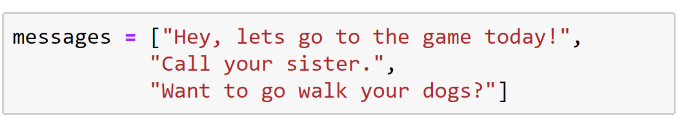
Natural Language Processing
Count Vectorization

Slide 80
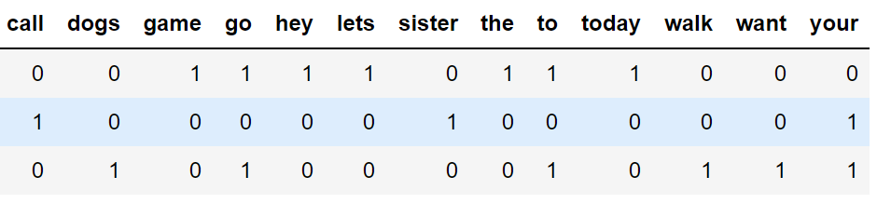
Natural Language Processing
Document Term Matrix (DTM)

Slide 81
Natural Language Processing
Count Vectorization treats every word as a feature, with the frequency counts acting as a “strength” of the feature/word.
For larger documents, matrices are stored as a sparse matrix to save space, since so many values will be zero.

Slide 82
Natural Language Processing
Issues to consider:
Very common words (e.g. “a” , “the”, “about”).
Words common to a particular set of documents (e.g. “run” in a set of different sports articles).

Slide 83
Natural Language Processing
Stop Words are words common enough throughout a language that its usually safe to remove them and not consider them as important.
Most NLP libraries have a built-in list of common stop words.

Slide 84
Natural Language Processing
We can address the issue of document frequency by using a TF-IDF Vectorization process.
Instead of filling the DTM with word frequency counts it calculates term frequency-inverse document frequency value for each word(TF-IDF).

Slide 85
Natural Language Processing
Term frequency tf(t,d): is the raw count of a term in a document:
The number of times that term t occurs in document d.

Slide 86
Natural Language Processing
However, Term Frequency alone isn’t enough for a thorough feature analysis of the text!
Let’s imagine very common terms, like “a” or “the”...

Slide 87
Natural Language Processing
Because the term "the" is so common, term frequency will tend to incorrectly emphasize documents which happen to use the word "the" more frequently, without giving enough weight to the more meaningful terms "red" and "dogs".

Slide 88
Natural Language Processing
We also need to consider a group of documents where non stop words are common throughout all the documents:
The word “run” in documents about various sports.

Slide 89
Natural Language Processing
An inverse document frequency factor is incorporated which diminishes the weight of terms that occur very frequently in the document set and increases the weight of terms that occur rarely.

Slide 90
Natural Language Processing
It is the logarithmically scaled inverse fraction of the documents that contain the word (obtained by dividing the total number of documents by the number of documents containing the term, and then taking the logarithm of that quotient)

Slide 91
Natural Language Processing
The IDF is how common or rare a word is in the entire document set.
The closer it is to 0, the more common a word is.
Calculated by taking the total number of documents, dividing it by the number of documents that contain a word, and calculating the logarithm.

Slide 92
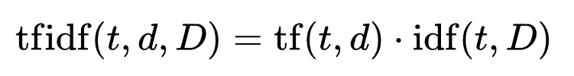
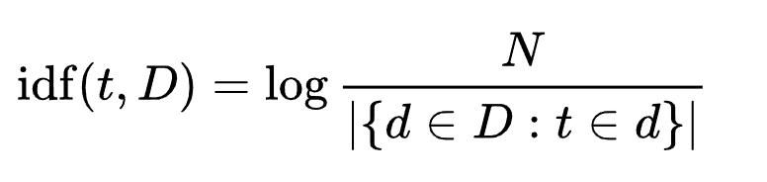
Natural Language Processing
TF-IDF = term frequency * (1 / document frequency)
TF-IDF = term frequency * inverse document freq

Slide 93
Natural Language Processing
Fortunately Scikit-learn can calculate all these terms for us through the use of its API.
Notice how similar the syntax is to our previous use of ML models in Scikit-Learn!

Slide 94
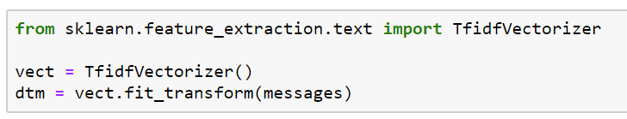
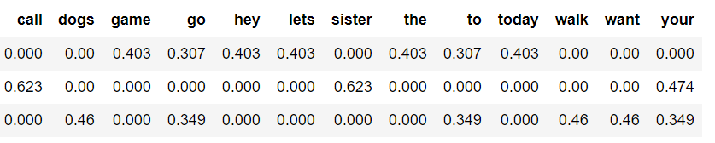
Natural Language Processing

Slide 95
Natural Language Processing
TF-IDF allows us to understand the context of words across an entire corpus of documents, instead of just its relative importance in a single document.
Coming up next we’ll explore how to perform these operations with Python and SciKit-Learn!

Slide 96
Extracting Features From Text Data
Understanding Core Concepts

Slide 97
Natural Language Processing
Let’s begin understanding core concepts by manually creating a “bag of words” model.
Recall that this is a frequency count of words in the documents.
Let’s get started!

Slide 98
Extracting Features From Text Data
Utilizing Scikit-Learn

Slide 99
Classification with
Text Data
Part One: Data Analysis and Features

Slide 100
Classification with
Text Data
Part Two: Building Models

Slide 101
Text Classification
Project Exercise
Solutions

